Slide 1
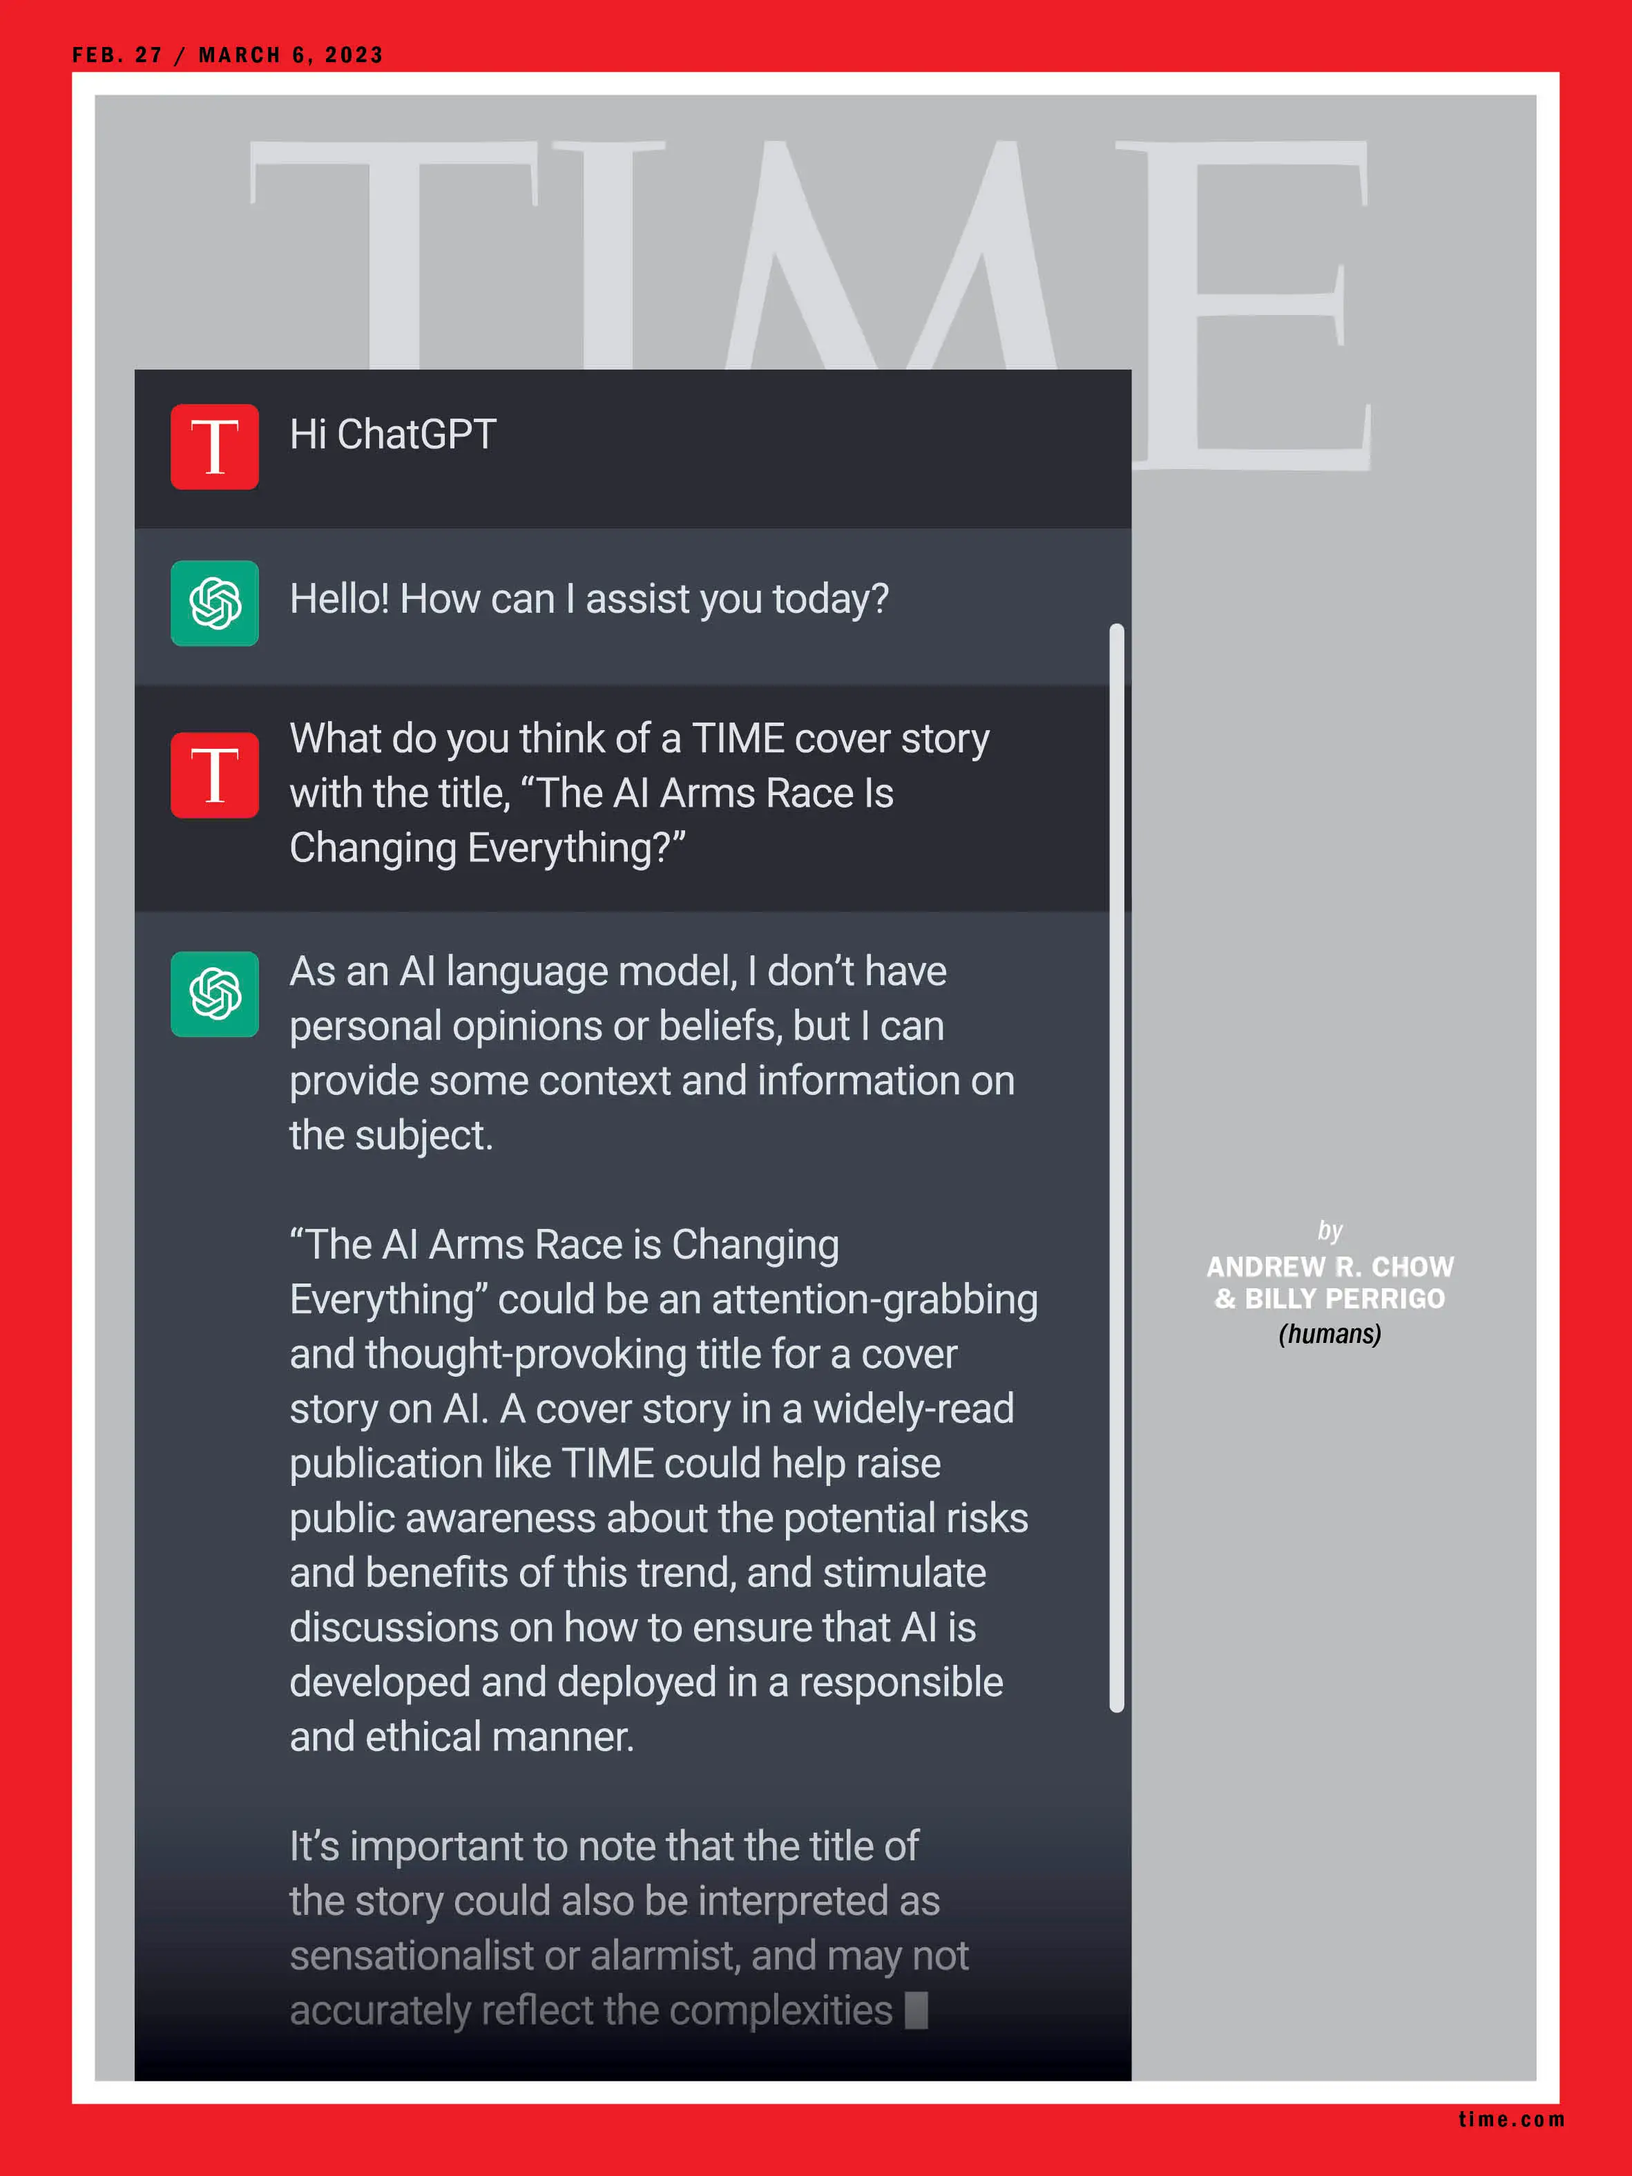
提示工程
如何与生成式 AI 高效沟通
张原鸣
北京交通大学，计算机科学与技术学院
ymzhang23@bjtu.edu.cn
ChatGPT 登上《时代》杂志封面

Slide 2
目录
生成式AI的工作特点
什么是提示工程
提示工程的技术原理与方法论

Slide 3

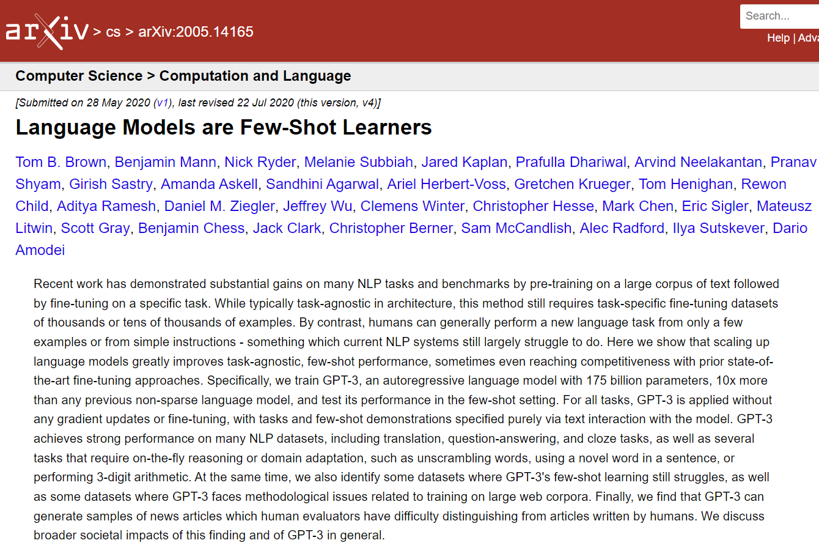
生成式AI的工作特点
GPT was designed to guess the next word or complete a sentence in a human-generated text, and an immense number of human-generated texts trained its model. ^{[1]}
Cited from ChatGPT and Open-AI Models: A Preliminary Review,
a review paper by Roumeliotis, K.I. and Tselikas, N.D.
2020 年提出 GPT-3 概念的论文
(Brown et al. 2020)

Slide 4
How Prompts Work in Generative AI
*作者：张原鸣
System Prompt
built-in prompt providing context and instructions to the model
Delivering a strong academic speech in English requires careful preparation, clear communication, and confidence. Here are some key tips to help you improve:
1. Understand Your Audience
Know the audience: Consider the knowledge level and interests of your audience. Tailor your content to be accessible yet insightful.
…
LLM
Large Language Model
User Prompt
requirements provided by users
Prompt Set
Generated Texts

Slide 5
什么是提示工程
Prompt engineering is the process of structuring an instruction that can be interpreted and understood by a generative AI model.
——Wikipedia
Designing a prompt is essentially how you "program" a model like GPT-4, usually by providing instructions or some examples of how to successfully complete a task.
——OpenAI
Prompt engineering adds context to the prompt by providing instructions, examples, and cues to help the model produce better completions.
——Microsoft Learn
Prompt engineering is the art of communicating with a generative AI model.
——Github Blog

Slide 6
A Systematic Survey of Prompt Engineering in Large Language Models: Techniques and Applications
Pranab Sahoo, Ayush Kumar Singh, Sriparna Saha, Vinija Jain, Samrat Mondal, Aman Chadha
arXiv:2402.07927
Abstract
“This survey paper addresses the gap by providing a structured overview of recent advancements in prompt engineering, categorized by application area.”
* Image captured from the paper on page 3.

Slide 7
提示工程的技术原理与方法论
1. 尽可能具体、描述性强且详细
2. 要求模型采用角色
3. 使用分隔符表示不同部分
4. 将复杂任务拆分为更简单的子任务
5. 说明要做什么而不是不要做什么
方法论

Slide 8
方法论
1. 尽可能具体、描述性强且详细
Worse
Write code to calculate the Fibonacci sequence.
Better
Write a Python function to efficiently calculate the Fibonacci sequence. Comment the code liberally to explain what each piece does and why it's written that way.

Slide 9
方法论
2. 要求模型采用角色
Worse
What’s the best time of year to enjoy New England’s fall foliage?
Better
You are an experienced wildlife biologist specializing in trees.
Based on the recent weather patterns in the USA, predict the best fall foliage season for New England—and explain it to kindergarteners.

Slide 10
方法论
3. 使用分隔符表示不同部分
Worse
This is my English homework. Please help me polish it up. Today is Mid-Autumn Festival. I am very happy. I ate mooncake with my family.
Better
I want you to act as an English teacher. I want you to replace my simplified words and sentences with more beautiful and elegant, upper-level English words and sentences.
"""
Today is Mid-Autumn Festival. I am very happy. I ate mooncake with my family.
"""

Slide 11
方法论
4. 将复杂任务拆分为更简单的子任务
Worse
Summarize these text and translate it to Spanish.
Better
Use the following step-by-step instructions to respond to my inputs.
Step 1 - I will provide you with text in triple quotes. Summarize this text in one sentence with a prefix that says "Summary: ".
Step 2 - Translate the summary from Step 1 into Spanish, with a prefix that says "Translation: ".

Slide 12
方法论
5. 说明要做什么而不是不要做什么
Worse
The following is a conversation between an Agent and a Customer. DO NOT ASK USERNAME OR PASSWORD. DO NOT REPEAT.
Better
The following is a conversation between an Agent and a Customer. The agent will attempt to diagnose the problem and suggest a solution, whilst refraining from asking any questions related to PII. Instead of asking for PII, such as username or password, refer the user to the help article www.samplewebsite.com/help/faq

Slide 13
延伸阅读
Prompt Engineering / OpenAI Platform
https://platform.openai.com/docs/guides/prompt-engineering/strategy-write-clear-instructions
Best practices for prompt engineering with the OpenAI API / OpenAI Help Center
https://help.openai.com/en/articles/6654000-best-practices-for-prompt-engineering-with-the-openai-api
Effective Prompts for AI: The Essentials / MIT Sloan Teaching & Learning Technologies
https://mitsloanedtech.mit.edu/ai/basics/effective-prompts/#Writing_Effective_Prompts

Slide 14
谢谢

Slide 15
参考文献
Roumeliotis, K. I., & Tselikas, N. D. (2023). ChatGPT and Open-AI Models: A Preliminary Review. Future Internet, 15(6), 192. https://doi.org/10.3390/fi15060192
Brown, T. B., Mann, B., Ryder, N., Subbiah, M., Kaplan, J., Dhariwal, P., Neelakantan, A., Shyam, P., Sastry, G., Askell, A., Agarwal, S., Herbert-Voss, A., Krueger, G., Henighan, T., Child, R., Ramesh, A., Ziegler, D. M., Wu, J., Winter, C., Hesse, C., Chen, M., Sigler, E., Litwin, M., Gray, S., Chess, B., Clark, J., Berner, C., McCandlish, S., Radford, A., Sutskever, I., & Amodei, D. (2020). Language Models are Few-Shot Learners. arXiv preprint. https://arxiv.org/abs/2005.14165
Wikipedia contributors. (2024). Prompt engineering. Wikipedia, The Free Encyclopedia. Retrieved September 10, 2024, from https://en.wikipedia.org/wiki/Prompt_engineering
OpenAI. (n.d.). Engineering / OpenAI Platform. Retrieved September 10, 2024, from https://platform.openai.com/docs/guides/prompt-engineering/strategy-write-clear-instructions
OpenAI. (n.d.). Best practices for prompt engineering with the OpenAI API. Retrieved September 10, 2024, from https://help.openai.com/en/articles/6654000-best-practices-for-prompt-engineering-with-the-openai-api
MIT Sloan Teaching & Learning Technologies. (n.d.). Effective Prompts for AI: The Essentials. Retrieved September 10, 2024, from https://mitsloanedtech.mit.edu/ai/basics/effective-prompts/#Writing_Effective_Prompts
Sahoo, P., Singh, A. K., Saha, S., Jain, V., Mondal, S., & Chadha, A. (2024). A Systematic Survey of Prompt Engineering in Large Language Models: Techniques and Applications. arXiv preprint. https://arxiv.org/abs/2402.07927

